Slide 1

ACCESSS TO INTERNET AS A
HUMAN RIGHT
By Ara Ghazaryan

Slide 2
  Is access to internet a fundamental human right ?
  If so,
  does the government have positive obligation to ensure that everyone has access to internet

Slide 3
UN World Summit on the Information Society
  December of 2003
  “common desire and commitment to build a people-centered, inclusive and development-oriented Information Society, where everyone can create, access, utilize and share information and knowledge, enabling individuals, communities and peoples to achieve their full potential in promoting their sustainable development and improving their quality of life, premised on
  the purposes and principles of the Charter of the United Nations and respecting fully and upholding the Universal Declaration of Human Rights.”

Slide 4
OSCE
  Survey among states 2008-2010
  Do the States have:
specific legal provisions on the right to access the Internet
2. general legal provisions which could restrict users’ access to the Internet.
The number of worldwide users:
Yes - 30.3%
No - 51.8%
No – 69.6%
Yes – 12.5%
5 bln.
It means access to internet has universal recognition.
Everyone has the right to participate in the information society.
The state has a responsibility to assist in the advancement of it.

Slide 5
UN special rapporteur report
  Frank La Rue
  May 2011
  Internet enables individuals to seek, receive and impart information and ideas of all kinds - instantaneously and inexpensively across national borders,
  while the Internet has been in existence since the 1960s, it is the way people now use the Internet, across the world and across age groups, with "incorporation into virtually every aspect of modern human life," that makes the Internet an unprecedented force,
  indispensable tool for realizing a range of human rights, combating inequality, and accelerating development and human progress,

Slide 6
ECHR caselaw
27. The Court has consistently emphasized that Article 10 guarantees not only the right to impart information but also the right of the public to receive it…In the light of its accessibility and its capacity to store and communicate vast amounts of information, the Internet plays an important role in enhancing the public’s access to news and facilitating the dissemination of information in general. The maintenance of Internet archives is a critical aspect of this role and the Court therefore considers that such archives fall within the ambit of the protection afforded by Article 10.
Times Newspapers Ltd. v. United Kingdom (Nos. 1 and 2) (2009)
http://hudoc.echr.coe.int/eng?i=001-91706

Slide 7
ECHR caselaw
Google service constitutes a means of exercising freedom of expression” (§ 49).
“The TİB…blocked access to the entire Google Sites domain, thereby incidentally preventing the applicant from accessing his own website…He can therefore legitimately claim that the measure in question affected his right to receive and impart information and ideas” (§ 51).
The Court considers that, whatever its legal basis, such a measure was bound to have an influence on the accessibility of the Internet and, accordingly, engaged the responsibility of the respondent State under Article 10 (§ 53).
Ahmet Yildirim v. Turkey (2012)
http://hudoc.echr.coe.int/eng?i=001-115705

Slide 8
  Thus, access to internet is recognized as
  fundamental human right
  under free speech doctrine

Slide 9
How the access of users is affected
  Content Blocking
  Content Filtering
  Content Removal

Slide 10

Blocking
  Measures taken to prevent certain content from reaching an end user. The content remains but users cannot reach to it and see it.
  This includes blocking:
  IP blocking - block all traffic to a set of IP addresses
  DPI – list of content to block identified by keywords or image matching,
  URL blocking – blocks URL web traffic identified by category (e.g. sports)
  Platform-based blocking – e.g. Facebook, Youtube
  DNS – blocks domain names

Slide 11
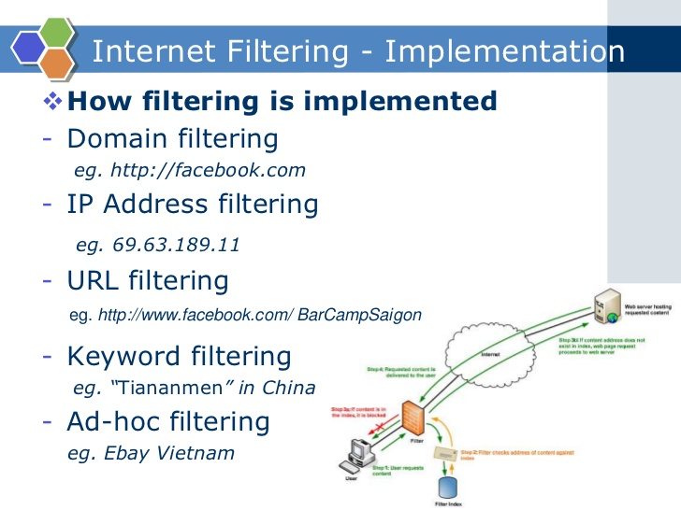
Filtering
  Configured blocking of content based on categories and sub-categories.
  Difference between filtering and blocking
  example: (emails)
A filtering software lets unsolicited e-mails with offending content to land in your inbox but then automatically removes them to another folder (spam folder or trash folder) that you have created.
A blocking softwire prevents such emails from reaching your account. They are rejected and therefore do not land in your inbox, spam folder or any other folder that you may have created.

Slide 12

Removal
  Removal means taking down the content from the internet. If blocking and filtering presumes that the content stays but the user cannot reach and see it, the removal means the content is taken down from the cyberspace.

