Slide 1
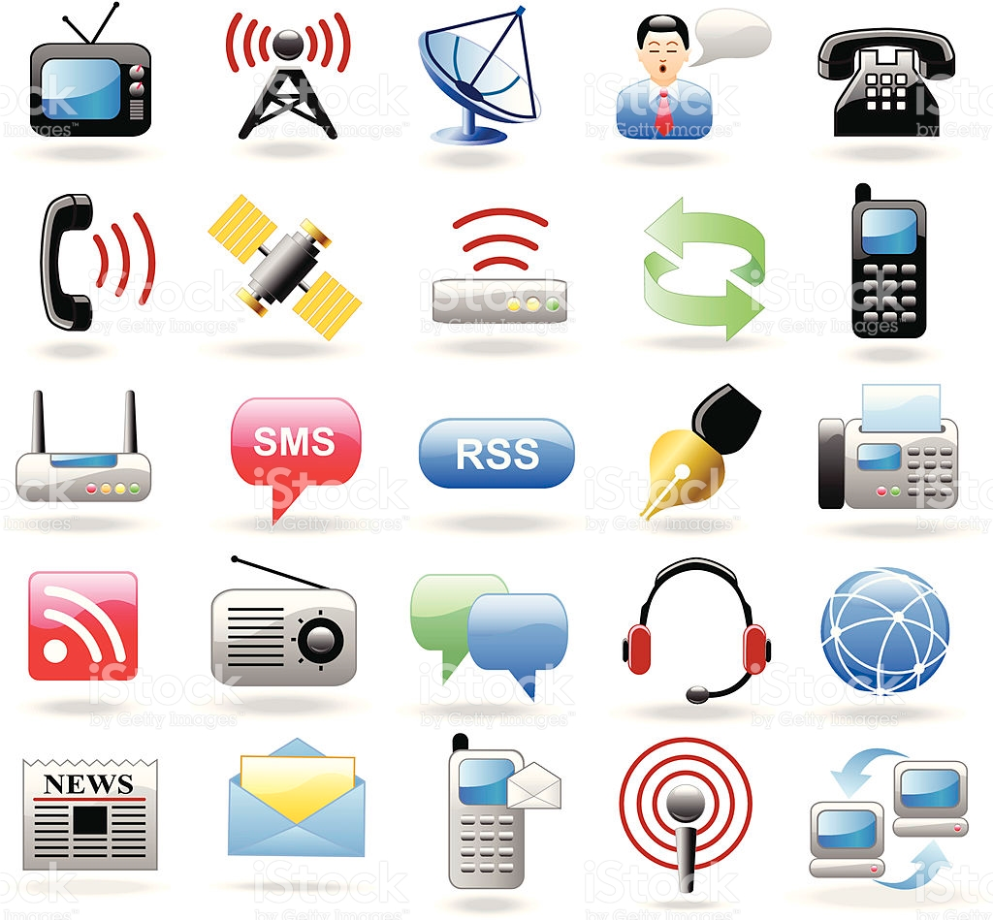
INTERNET AS A NEW INFORMATION MEDIUM
By Ara Ghazaryan

Slide 2



World without Internet
Good old days
Information source
Destination
Transmitter
Receiver

Slide 3


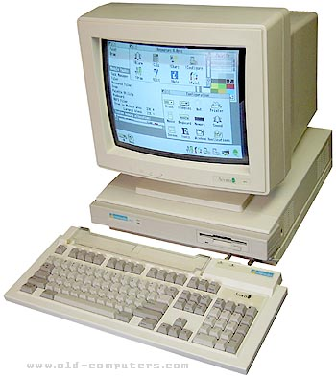

Web 1.0
Information source
Destination
Transmitter
Receiver
A set of static websites that were not yet providing interactive content.
A read-only web.

Slide 4
Web 1.0 Internet
  A set of static websites that were not yet providing interactive content.
  A read-only web.
  User was able to:
    search information.
    read information
  Little interaction and content distribution
  Website owners wanted to show their presence and make their information available to any one at a time.

Slide 5

Web 2.0
Early days
Information source
Destination
Transmitter
Receiver

Slide 6


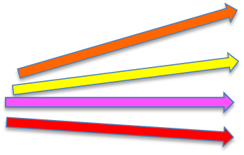
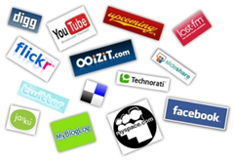
Web 2.0
Information source
Destination
Transmitter
Receiver
User generated content
P2P

Slide 7
Web 2.0 Internet
  A set of websites that provide interactive content.
  A read-write-contribute-interactive web.
  User was able to:
    search
    read
    produce content
    remove content
      Interact
  Producer of information is user of information, and vice versus.
  User is content generator.
  Peer to Peer (P2P) web.

Slide 8

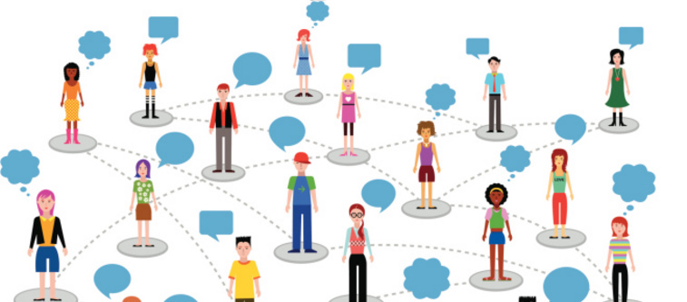
User generated content
  It’s a democratization of content production
  Traditional gatekeepers (newspaper editors, publishers, media tycoons) that approved all content before it was aired or published, disappeared.
  Every single user is media/content producer.
  Every single user is New York Times – hitting “enter” key once will spread information to millions.
  large numbers of individuals are able to post text, digital photos and digital videos online, with little or no "gatekeepers" or filters.

Slide 9
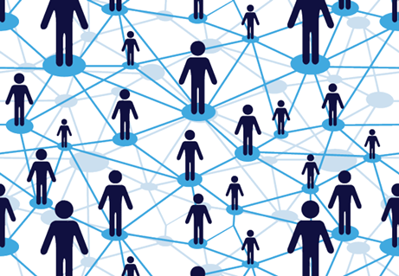
Web 2.0 Internet
Examples of Web 2.0 features:
social networking sites (e.g. Facebook)
social media (e.g. Linkedin)
blogs,
wikis,
video sharing sites (e.g., YouTube),
hosted services (e.g. RapidShare file hosting and sharing service)
Web applications
collaborative consumption platforms
mashup applications.

Slide 10
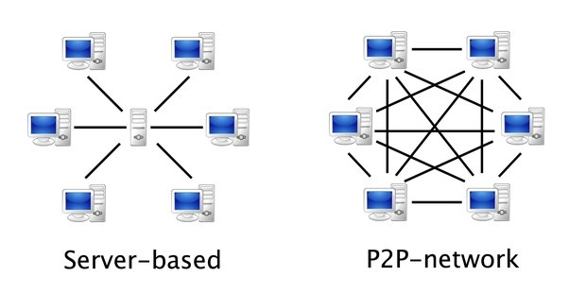
P2P network
  Peer to peer network
  Content user is also content producer, and vice versus.
  Each user acts as a server – shares, distributes, blocks, removes, filters like servers or gatekeepers.
  All users are peers.
  All peers are equally privileged.
  All peers are both suppliers and consumers
  All peers have equal rights and responsibilities.
  Traditional client-server model, in which consumption and supply of resources is divided, is not applicable.

Slide 11
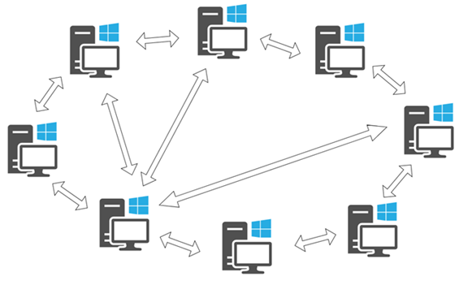
Legal implications of user-generated content
  Users establish virtual network entirely independent from the physical network - without having to obey any administrative authorities, regulators or traditional legal barriers.
  No “client-server” model – each person simultaneously acts as both “client” and “server” to the other person.
  Challenge to intellectual property right, defamation and privacy
    e.g. share or distribute files without consent/knowledge of copyright owner
  Anonymity on the net
  Liability of ISP and network operators for unlawful content
  Direct infringement, contributory infringement, vicarious infringement
  Third party liability (e.g. liability for comments)
  Media convergence

