Slide 1
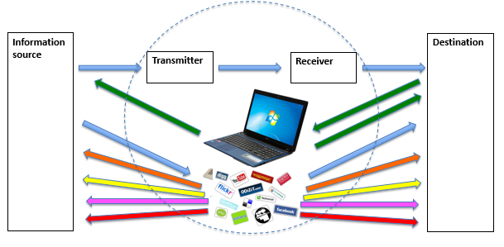
LIABILITY OF INTERMEDIARY
SERVICE PROVIDERS
By Ara Ghazaryan

Slide 2




Who are the intermediaries ?
  Internet service providers (ISP)
  Comcast Xfinity offers cable Internet service across 40 states to approximately 110 million people.
  AT&T Internet Offers high speed Internet service to 22 states.
  News agencies
  www.bbc.com
  www.cnn.com
  News aggregators
  Social networks

Slide 3








Intermediaries ?
  Commercial services
  www.ebay.com
  www.cheaptickets.com
  Libraries/archives/court decisions
  User generated content sites
  Create
  X-files
WikiLeaks

Slide 4
Intermediaries
  They provide interactive online services
  They are medium of information
  They are carrier of information
  They provide portal for posting of information
  Mere conduit of information
  They do not produce content, they simply act as a medium of information, or information conduit
  SHOULD THEY BE LEGALLY LIABLE FOR UNLAWFUL CONTENT PRODUCED BY OTHERS!!

Slide 5
EU E-Commerce Directive 2000/31/EC
(42) The exemptions from liability … cover only cases where the activity of the … service provider is limited to the technical process of operating and giving access to a communication network over which information made available by third parties is transmitted or temporarily stored, for the sole purpose of making the transmission more efficient; this activity is of a mere technical, automatic and passive nature, which implies that the … service provider has neither knowledge of nor control over the information which is transmitted or stored.
http://eur-lex.europa.eu/legal-content/EN/TXT/PDF/?uri=CELEX:32000L0031&from=EN

Slide 6
EU E-Commerce Directive 2000/31/EC
Article 14
Hosting
1. service provider is not liable for the information stored at the request of a recipient of the service, on condition that:
(a) the provider does not have actual knowledge of illegal activity or information and, as regards claims for damages, is not aware of facts or circumstances from which the illegal activity or information is apparent; or
(b) the provider, upon obtaining such knowledge or awareness, acts expeditiously to remove or to disable access to the information.
“Notice and take down” defense – see Delfi AS case

Slide 7
EU E-Commerce Directive 2000/31/EC
(43) A service provider can benefit from the exemptions for ‘mere conduit’ and for ‘caching’ when he is in no way involved with the information transmitted; this requires among other things that he does not modify the information that he transmits; this requirement does not cover manipulations of a technical nature which take place in the course of the transmission as they do not alter the integrity of the information contained in the transmission.

Slide 8
EU E-Commerce Directive 2000/31/EC
Article 15 – No general obligation to monitor
1. Member States shall not impose a general obligation on providers…to monitor the information which they transmit or store, nor a general obligation actively to seek facts or circumstances indicating illegal activity.

Slide 9
United States
Section 230 of the Communications Decency Act
“No provider or user of an interactive computer service shall be treated as the publisher or speaker of any information provided by another information content provider”.
To claim immunity, interactive service provider:
must be “Provider” or “user" of "interactive computer service.“
Must not be the producer (author) of the unlawful content

Slide 10
US – absolute protection from liability
“No provider or user of an interactive computer service shall be treated as the publisher or speaker of any information provided by another information content provider”.
EU – limited protection from liability
Knowledge
Control
The ground for “Notice and Take Down” defense

